Slide 1
11. Political Parties
& Interest Groups
Breakout Sessions
POLS 1101
12:40pm-1:30pm Park Hall 145
& 1:50pm-2:40pm Leconte Hall 135
SIYUAN (Siri) ZHAO
Siri.Zhao@uga.edu

Slide 2
Exam Hand Back
Add points wrong
  WITHIN TODAY (Friday) , or right after class
Questions on why I lost points in short-answers
  WITHIN TODAY (Friday), or right after class
Appeal your grade
  WITHIN 24 hours (Friday & Saturday)
  Do as told by the syllabus
    You must write a statement to have the assignment regraded saying why you believe you should have received more credit and you will need to give me your blue book.
    If you appeal your grade, I (your TA) will need to regrade which could result in a higher grade, a lower grade, or no change at all.
    Only submit an appeal if you are sure that you can make a strong case for a higher score!
    If you are still unsatisfied with your grade after that, you can repeat the process with Professor Nicholson.

Slide 3
Mid term 2 Feedback
Pay attention to basic ideas / details that can be covered in MC questions.
Try to use bullet points.
  Make your ideas easy to identify — graders can quickly locate your key points and give credit.
Use enough space — don’t squeeze your writing at the bottom of the page.
  It’s totally fine to turn the page. Make your answers clear and easy to read!
When your answer isn’t included in textbook / slides but makes sense, I give you credits that I think appropriate.
  I’m happy to see your own thinking, since we cannot remember everything.
  However, still try to review carefully, since some of your own ideas can overlap with each other – in essence they refer to the same “key concept”. In this case, maybe you don’t get a full credit.

Slide 4
Political Parties & Interest Groups
Dimension | Political Parties | Interest Groups
Definition | An organization that sponsors candidates for political office under the organization’s name | Organized associations that seek to influence public policy without running candidates for office.
Core Functions | Nominate candidates for public office Organize election campaigns Propose alternative government programs Coordinate the actions of government officials | Representation Participation Education (political socialization) Agenda building Program monitoring
Membership Base | Broad and diverse, representing wide social segments (e.g., multiple classes, regions, ideologies). | (Often) Narrow and specialized, often representing particular occupations, industries, or causes.
Organizational Structure | Hierarchical, with national, state, and local branches; formal leadership and membership. | May be highly professionalized (e.g., trade associations) or loosely organized (e.g., grassroots movements).
Relationship to Government | More direct. Actively nominate and run candidates. | More indirect. Do not run candidates; may endorse or fund them indirectly.

Slide 5
Political Parties & Interest Groups (cont`d)
Dimension | Political Parties | Interest Groups
Main Strategies | - Electoral competition - Coalition-building (in multi-party systems / parliamentary systems) - Legislative and executive action | - Lobbying - Campaign contributions (PACs/Super PACs) - Litigation - Grassroots mobilization - Media and public campaigns
Source of Legitimacy | Popular mandate through democratic elections. | Expertise, resources, and member support.
Role for Citizens | Provides choices in elections; connects voters to governing institutions. | Channels citizen interests into policy advocacy (often biased toward the benefits of the upper-class); gives voice to specific concerns.
Theoretical Foundation | Reflects majoritarian democracy and responsible party government. | Embodies pluralist democracy, where multiple organized interests compete for influence.
Can a large interest group ever become similar to a political party? Why or why not?
Why might politicians rely on interest groups even when they belong to strong parties?

Slide 6
The American Two-Party System
The Preparty Period
  Why did political parties emerge in the early history of the U.S, despite George Washington’s warning against “factions”?
  Could democracy function effectively without political parties?
The Evolution of the Party System
  Why do parties operate differently in parliamentary systems (e.g., the U.K. or Canada) than in the U.S.?
  Is the current two-party system still capable of representing America’s diversity?
  or, Are the minor parties essential to the U.S. politics?

Slide 7
The American Two-Party System (cont`d)
Why a two-party system? The electoral system
  Majority representation: one office is won by the single candidate who collects the most votes (simple plurality, tending to produce two competing powers)
  Proportional representation: legislative seats are awarded to a party in proportion to the vote that party wins in an election. (tending to produce several parties)
Term | Definition | Example | Common Use Cases
Relative Majority (Simple Plurality) | A candidate/option wins if it has more votes than any other, but not necessarily more than half of all votes. | Candidate A: 40 votes, Candidate B: 35, Candidate C: 25 → A wins with 40 (not >50%). | U.S. congressional elections, U.K. House of Commons elections (first-past-the-post).
Absolute Majority | A candidate/option must receive more than half (>50%) of all votes cast to win. | Total votes = 100 → a candidate needs at least 51 to achieve absolute majority. | Presidential elections in France (two-round system), parliamentary votes requiring >50%.

Slide 8
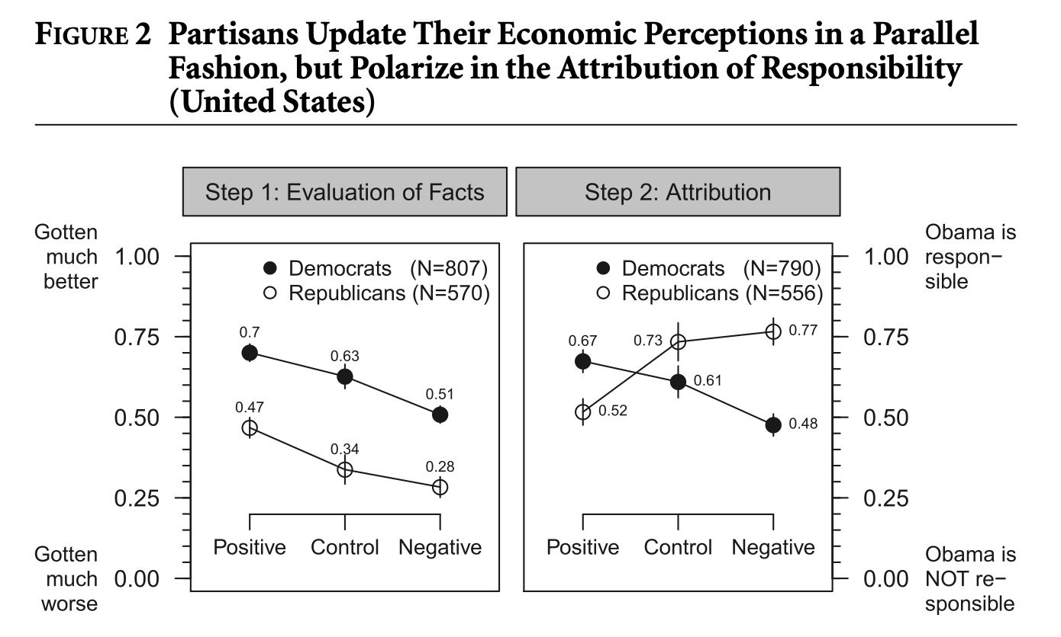
The American Two-Party System (cont`d)
Why always the two parties?
  Shaped by the president election – as many votes as possible!
  The historical pattern of political socialization
    The two parties persist simply because they have persisted.
    Party identification, shaped by income, education, religion, ethnicity, age, gender, region, parents…
How important is party identification?
  An example: Bisgaard (2019) AJPS
  “The acknowledgement of new facts
  can lead citizens to reason about
  the question of responsibility in a
  highly partisan-motivated fashion.”
Notes:
Minimal unit / requirement for competition

Slide 9
Party Organizations
National Party Organizations
  National convention: nominate a presidential candidate; supreme governing body
  National committee: RNC, DNC
    They do NOT direct or control the crucial presidential campaigns.
  Congressional party conferences: select party leaders; decide committee assignments (only within the Congress)
  Congressional campaign committee
    Despite the weakness of national party committees, both party organizations were strong in Congress. -> Why?
State and Local Party Organizations
  American political parties are characterized by decentralization, despite the party machine (a centralized organization that dominated local politics by controlling elections). The individual state and local party organizations vary widely in strength.
Notes:
National party committees are organizationally weak because the U.S. party system is decentralized,
but congressional party organizations are strong because legislative control (clear goal!), leadership incentives (Congress competition is (maybe) all about party competitions!), and campaign resources concentrate in Congress.
美国政党体系整体分散、地方化，使全国党委员会权力有限；
但国会党团因掌握立法权、资源与席位竞争，反而形成了实质性的组织力量。
Federalism
Power in the United States is divided between national, state, and local governments.
Each level conducts its own elections and has its own party organizations.
State and local party committees therefore retain substantial autonomy, and no national leader can fully control them.
Separation of Powers
The executive and legislative branches are elected independently.
This means party members in Congress or in state legislatures do not depend on the president or governor for their positions.
As a result, party loyalty is weaker and coordination across branches is limited.
Candidate-Centered Elections
American elections emphasize individual candidates more than party platforms.
Primaries allow voters to choose nominees directly, reducing the influence of party elites.
This system makes parties “bottom-up” coalitions rather than “top-down” hierarchies.
Historical and Cultural Factors
Americans traditionally distrust concentrated power and value local independence.

Slide 10
The Model of Responsible Party Government
Remember: Ideal Type!
  Parties should present clear and coherent programs to voters.
  Voters should choose candidates on the basis of party programs.
  The winning party should carry out its program once in office.
  Voters should hold the governing party responsible at the next election for executing its program.
Discussion Questions
  Why is the responsible party model often considered a majoritarian model of democracy?
  In what ways does the U.S. party system fail to meet the standards of responsible party government? To what extent are they detrimental to American democracy?
  Would adopting a more responsible party model make American politics more effective or more polarized?

Slide 11
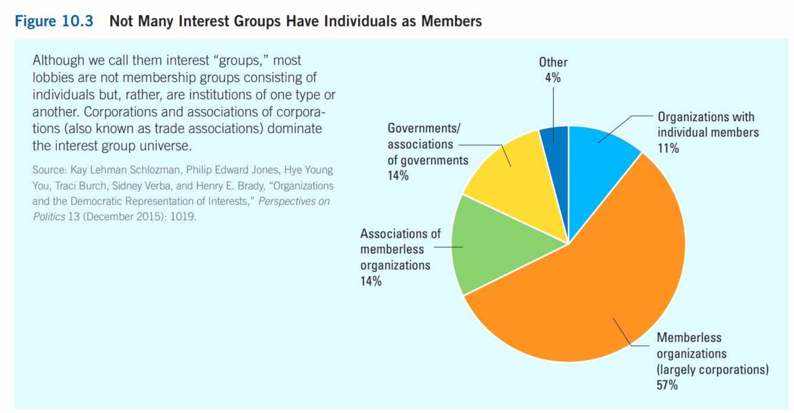
“Biased Representation” in Interest Groups
Facts
  Not all interest groups consist of individuals. (membership, memberless, government)
  Business organizations are overrepresented.
    Trade associations: An organization that represents corporations within an industry.
  Some business interests
  are better represented
  than others.
  When citizen interests are
  organized, the more
  advantaged are better
  represented than the
  less advantaged.
Coordination costs
Bargaining power

Slide 12
How do Interests Get Organized?
Awareness
  Growing awareness may result from an adverse change in circumstances or changing definitions of a problem. (Note: “constructed reality”)
Leadership
  The leader is called “interest group entrepreneur”.
Socio-economic status
  Upper-status groups are more likely to participate in politics. (Only minimal resources and limited channels to contact and recruit people from lower SES groups that contribute to lower levels of participation)
    BUT it doesn’t mean they can hardly be represented – citizen groups (lobbying organization built around policy concerns unrelated to members’ vocational interests)
    Can ordinary people rely on those “kind elites”?
  Actually, most of them did… - the free-rider problem in collective actions!
    How to solve the free-rider problem?
Notes:
选择性激励（Selective Benefits）
向成员提供非成员无法获得的独享福利，如会员杂志、保险优惠、职业资源或法律援助。
→ 例：美国退休者协会（AARP）通过提供旅游和保险优惠吸引了数百万会员。
团结性激励（Solidary Incentives）
通过社会互动与归属感吸引成员，成员因共同身份或社交关系而参与。
→ 例：环保组织常举办志愿活动，加强成员间的情感联系。
目标性激励（Purposive Incentives）
诉诸成员的道德信念或意识形态动机，让人们因“做正确的事”而自愿参与。
→ 例：人权组织通过道义感召而非物质利益吸引成员。
强制性机制（Coercion / Mandatory Membership）
某些职业协会或工会通过制度性要求强制成员缴费或加入，以确保经费来源。
→ 例：闭店工会（closed-shop unions）自动从员工工资中扣除会费。
政府支持与制度安排（Government Support & Institutional Design）

Slide 13
Actors of Interest Groups: Key Examples
Members & Volunteers (non-membership)
Lobbyists (full-time or part-time; experience, knowledge, and connections)
  “Revolving door” between the government and the private sector
  Agree / disagree? Advantages / problems?
Political Action Committees (PAC)
  Pooling campaign contributions from group members, and donating the money to candidates for political office ($ 5,000 at most to a candidate for Congress)
  Super PACs: They do not give money directly to candidates or parties, but there’s no restriction on their expenditures.
  Should limits on PAC contributions be increased, decreased, or abolished?
  Is money in politics a form of free speech or a source of inequality?

Slide 14
How do Interest Groups Exert Influence?
Direct lobbying (personal contact with policy makers)
  Grassroots lobbying: to affect public policy by using citizen contacts or pressure, by letter writing, protest or demonstration
  Astroturfing: “Mimic” grassroots support using paid consulting firms
Information campaigns
  An organized effort to gain public backing by bringing a group’s views to public attention. -> “public relations” (Note: Both an art and a science)
Coalition building
  The banding together of several interest groups for the purpose of lobbying
  Coalitions often extend beyond organizations with similar constituencies and similar outlooks. (consolidate those who share the same goal)
  Recall: “bureaucratic network” -> Similarities & Differences?

Slide 15
Are Interest Groups Effective?
Legislative
  Providing valuable, “local” information for policy makers
  No clear evidence that interest groups influence members of Congress’s decisions
Executive
  Rule making can be both very technical and complicated. Few citizens know how and when to participate.
  Therefore, interest groups can exert a great deal of influence.
Judicial
  Identifying potential cases, sponsoring litigation, and crafting legal arguments for judges to consider
Why can interest groups exert more influence in the rule-making process than in Congress?
Should courts limit the role of interest groups in identifying or sponsoring cases?
Notes:
Visibility (less visible in the executive branch)
Technical complexity (laws are less specific than policies)
Citizen participation (at least people can vote to congress members, which requires accountability by the citizens)
Fewer agents to make decisions (the costs of lobbying is relatively low)

Slide 16
Next week…
We have NO CLASS for next week (Fall Break 10.31 - Halloween!)
For the next next Week’s class, please read materials on Public Opinion & Media, and that will be helpful to participate in peer discussions.
Feel free to email me if you have any questions!
ENJOY YOUR WEEKEND!

